Slide 2
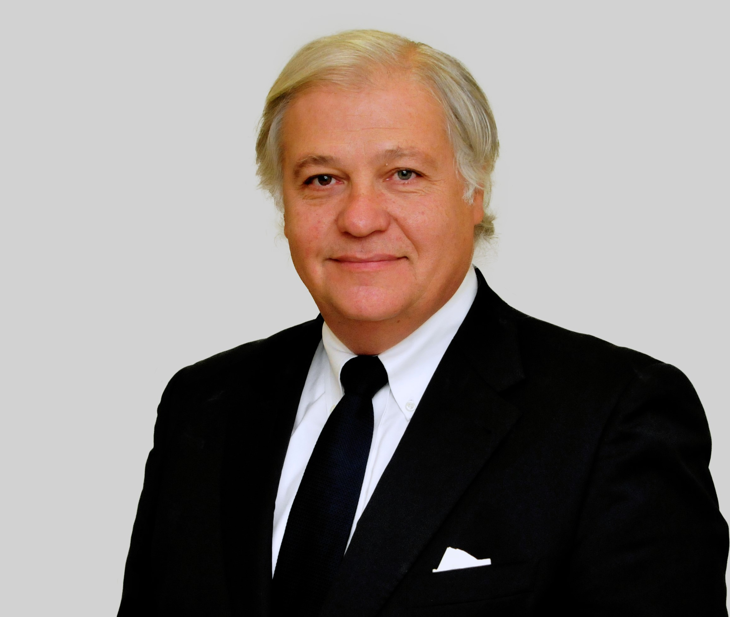
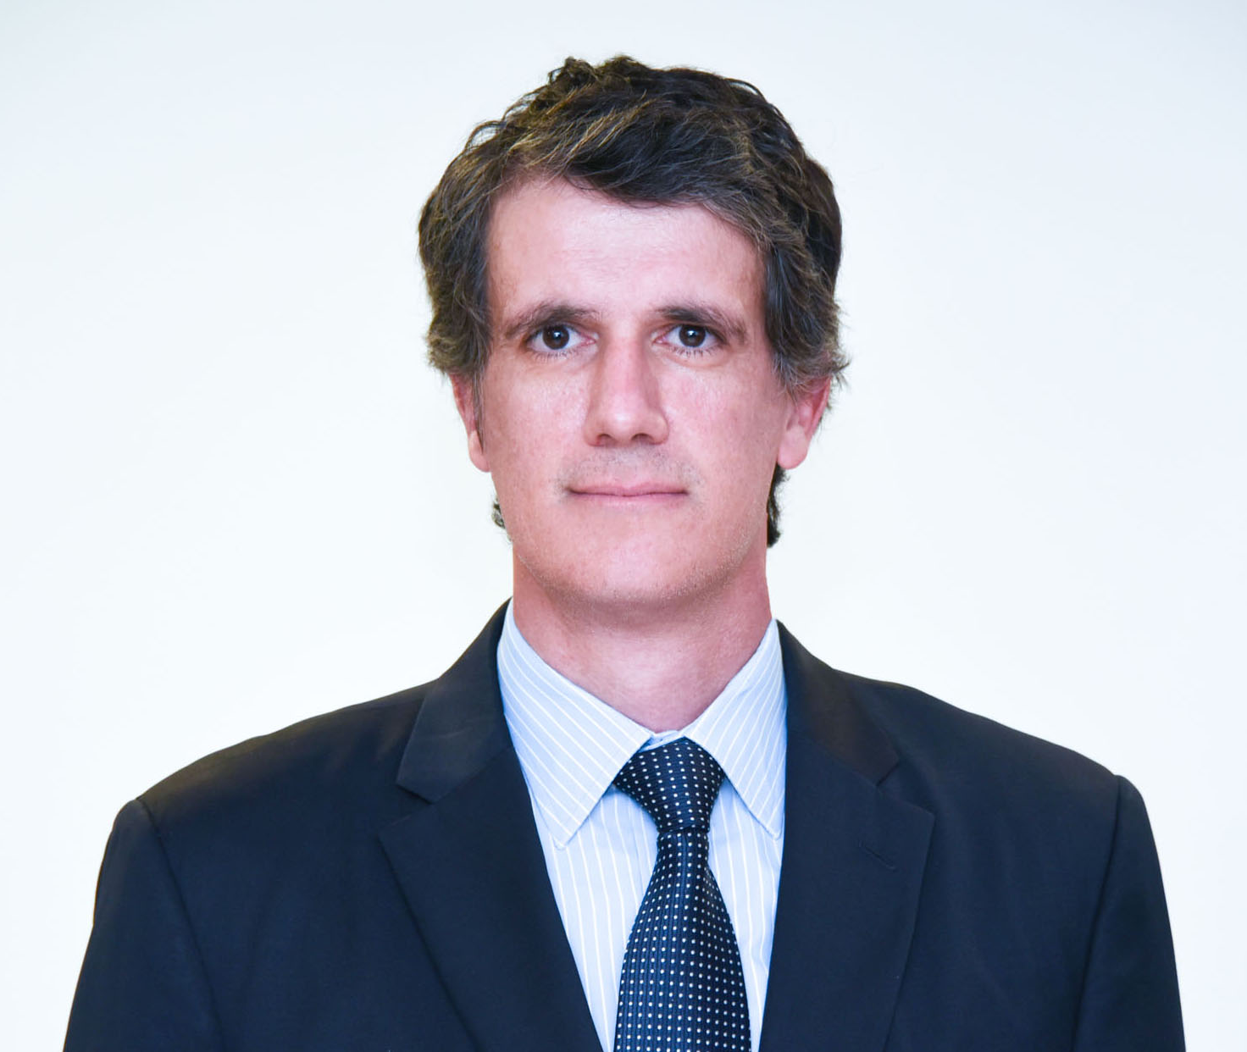
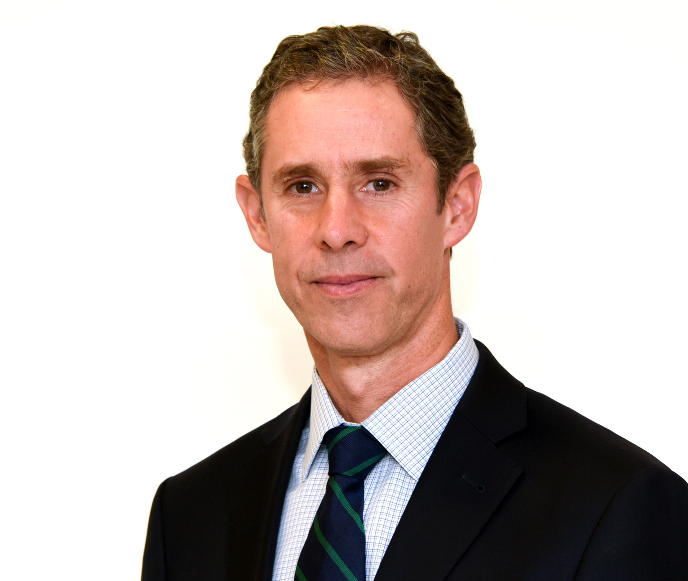
Jorge Granic
Projects and infrastructure Lawyer of the year
Cristóbal Morandé
Corporate and M&A (mid-market) y Energy & Natural Resources: Electricity & Gas Lawyer of the year
Patricio Montes
Banking and finance Lawyer
of the year

Slide 3
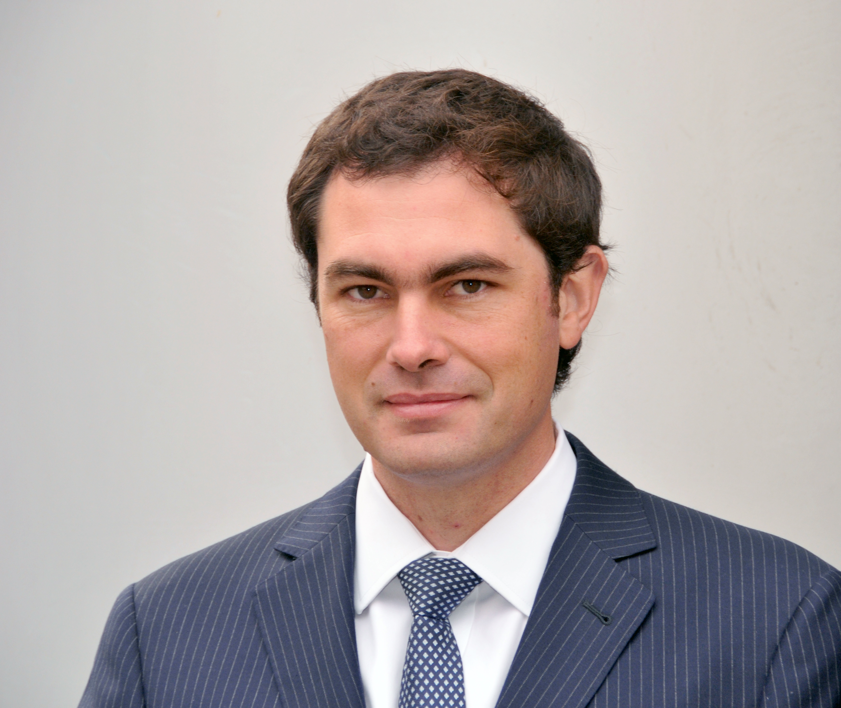
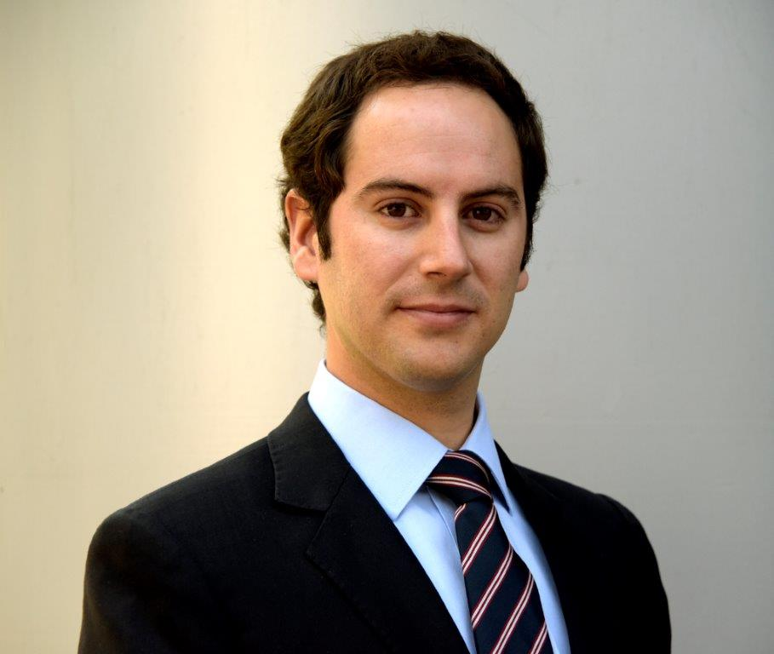
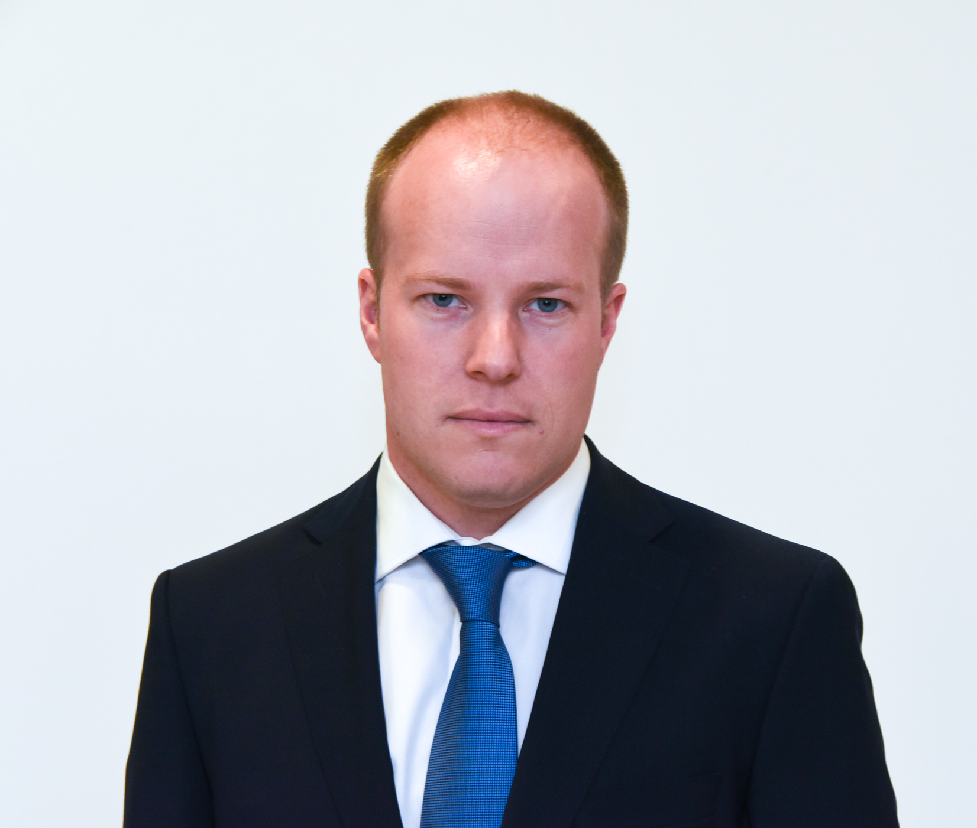
Juan Carlos Bulnes
Real Estate Lawyer of the year
Francisco Cerda
Energy & Natural Resources: Electricity & Gas y Projects and infrastructure Rising star of the year
Andrés Del Sante
Corporate and M&A (mid-market) Rising star of the year

